Slide 1
Medications for Weight Loss
Mohammed I. Tarrabain, M.D
St.Vincent Medical Group
Primary Care Symposium
April 11, 2015

Slide 2
Objective
Explore the efficacy, safety, and other factors to be considered regarding the use of medications for chronic weight management.
Part I
Approved Medications
Part II
“Off label”
Part III
Weight Promoting Meds
Part IV
Other Medications

Slide 3
PAST WT LOSS
THERAPIES -COMPLICATIONS
• Laxatives 200 AD -dehydration etc.
• Thyroid 1892 -hyperthyroidism
• Dinitrophenol 1932 -cataracts/neuropathy
• Amphetamine1937 -addiction
• Rainbow pills 1968 -deaths/arrythmia
• Fenfluramine 1997 -valvulopathy
• Dexfenfluramine -valvulopathy
• PPA1 1998 -strokes
• Ma Huang 2003 -heart attacks/strokes
• Ephedra 2004 -strokes/death
• Sibutramine 2011 -cardiovascular death

Slide 4
New anti-Obesity drugs
Hit the market in the past 3 years:
lorcaserin (Belviq)
phentermine/topiramate (Qsymia)
naltrexone/bupropion (Contrave)
liraglutide (Saxenda)

Slide 5
New Guidelines
Headed by the Endocrine Society with support from the Obesity Society and the European Society of Endocrinology.
The new guidelines expand on ones for managing overweight and obesity in adults that were released in 2013 by the Obesity Society, the American Heart Association, and the American College of Cardiology.

Slide 6
Classic Guidelines
USPSTF: “physicians should offer or refer their patients with obesity for high-intensity multicomponent behavioral interventions”
For patients who do not meet their target weight, intensification of therapy is needed. Options include: additional behavioral therapy; modifying dietary protocols; referral dietitian; the addition of pharmacotherapy that promotes weight loss; referral for bariatric surgery.

Slide 7
Natural History of Wt Loss Programs
With the best of lifestyle interventions, the average weight loss, was 5%-10% in 6 months.
Not all patients are successful in achieving even 5% WL due to compensatory mechanisms in appetite and metabolic rate.
Furthermore, the usual pattern after 6 months is a period of weight stabilization (plateau); or weight regain gradually in many patients.
the Look AHEAD study

Slide 8
Obesity Disease

Slide 9
Goals of Treatment
Indeed, in clinical studies of approved medications, substantially more patients are able to achieve 5% to 10%, or even 15% weight loss compared with placebo.
In practice, the weight loss goal for a patient is approximately 5% to 15%.
If achieved and maintained, these modest and moderate weight loss targets are well known to improve health indices.

Slide 10
Impact of weight loss
Bariatric surgical procedures produce weight loss by restricting the size of a meal (all procedures) and by their effects on gut hormones that affect appetite, such as gastric bypass and gastric sleeve. These procedures have been shown to not only produce weight loss, but to have a positive impact on diabetes, hypertension, dyslipidemia and even mortality.

Slide 11
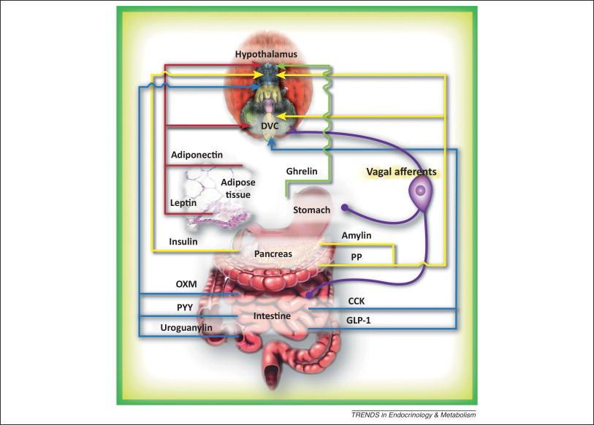

Slide 12
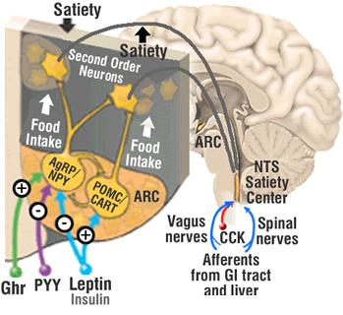

Slide 13
Rationale for using medications
Prescription medications serve as an adjunct to lifestyle changes in order to produce the negative energy balance that is required for weight loss.
Medication does not work on its own—however, it does suppress the appetite to help the patient ingest fewer calories.
With less hunger, more satiety, and the ability to resist food cues induced by medications that act on central appetite centers, patients will be better able to adhere to their diet.

Slide 14
“Obesity Based Medicine”
Medications are best suited for patients who are motivated to lose weight and adherent to lifestyle intervention since the combination is more effective than lifestyle intervention or pharmacotherapy alone.
While a wide variety of medications have been utilized to promote weight loss, only those shown to be effective and approved by the FDA for chronic obesity management should be utilized.
Some older medications are approved for short-term use, i.e. only a few weeks, but their use results in modest weight loss.

Slide 15
“Obesity as Chronic Condition”
long-term use of medication for weight loss is most effective when continued indefinitely.
The patient should be monitored periodically.
Address patient concerns, and provide ongoing support….(most important)

Slide 16
PHARMACOTHERAPY CRITERIA
body mass index (BMI) ≥30
or ≥27 who have other risk factors or diseases, (comorbidities) such as hypertension, dyslipidemia, cardiovascular disease, diabetes, fatty liver disease, and obstructive sleep apnea...

Slide 17
Part I
Approved Medications
Since obesity requires long-term management, most focus will be on those medications approved for long-term use.

Slide 18
Obesity Literature
(Rx v.s placebo)
Obesity trials are different than trials for other
chronic diseases, because:
IRB’s want the placebo group to get some help too.
The stronger the ancillary weight loss program, the greater the weight loss, but the difference between drug and placebo weight loss decreases.
Most obesity drug trials minimize the ancillary
program to maximize the difference.

Slide 19
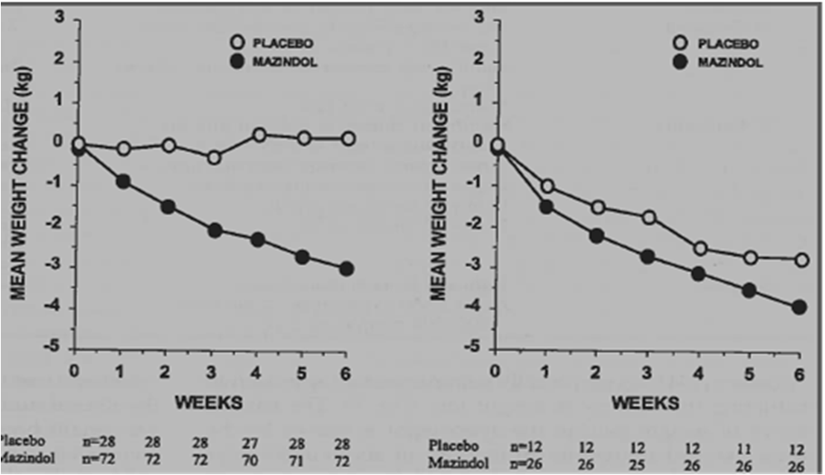
A Stronger Weight Loss Program Gives
More Weight Loss, Less Difference

Slide 20
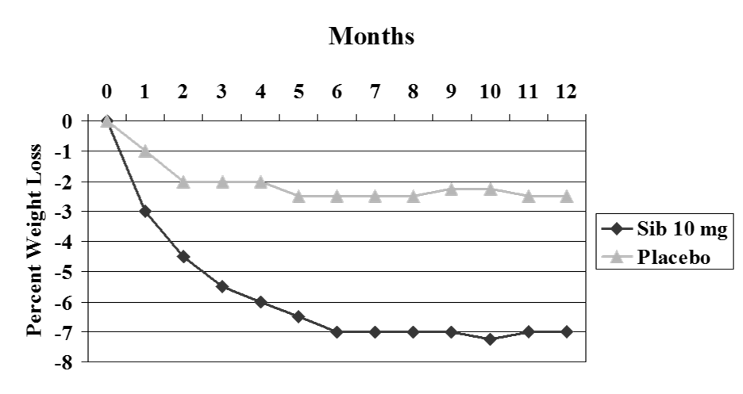
“significant weight loss”

Slide 21
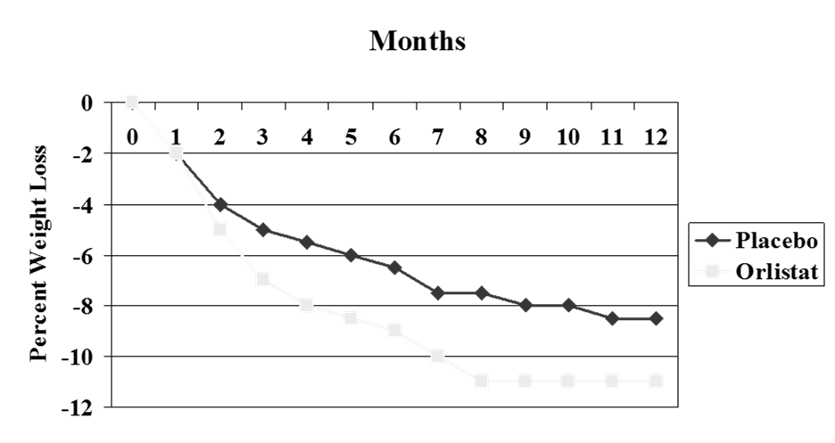
“sustained long term”

Slide 22
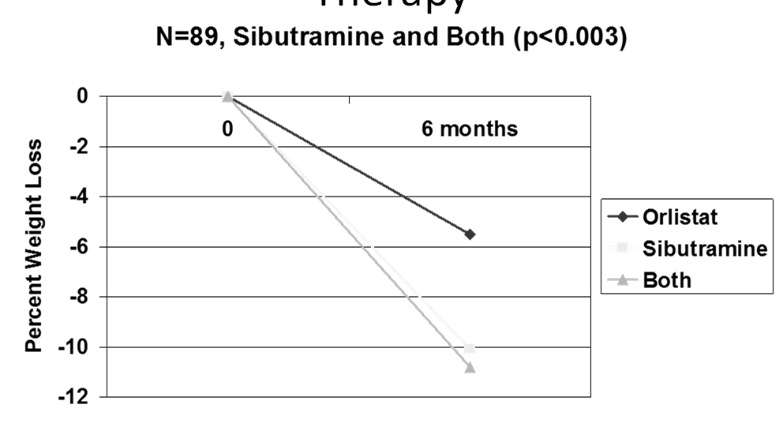
Weight Loss with Combination
Therapy

Slide 23
Current “Combination Rationale”
Because combination pharmacotherapy for obesity deploys medications with differing mechanisms of action, it offers the prospect of overcoming the counter-regulatory mechanisms that become manifest in the weight-reduced state.
Combination therapy also allows prescription of lower doses of each medication to minimize adverse effects

Slide 24
Two Drugs for Weight Loss
In 2012, the FDA approved one new drug and a new combination of 2 old drugs as adjuncts to lifestyle changes for chronic weight management.
Qsymia is a fixed-dose combination of the weight-loss drug phentermine and an extended-release (ER) formulation of topiramate.
Belviq (Lorcaserin)is a selective serotonin (5HT) 2C receptor agonist.

Slide 25
Qsymia
(CONQUER): a randomised, placebo-controlled, phase 3 trial.
Interpretation:
The combination of phentermine and topiramate, with office-based lifestyle interventions, might be a valuable treatment for obesity that can be provided by family doctors.
JAMA. 2013;310(6):637-638.

Slide 26
Qsymia
The CONQUER, SEQUEL, and EQUIP trials involved 4,426 overweight or obese patients.
Results of the 3 trials showed that the combination of diet and lifestyle intervention with phentermine/topiramate ER (at doses of 3.75 mg/23 mg, 7.5 mg/46 mg, or 15 mg/92 mg once daily) led to significantly greater reductions in body weight and waist circumference than the combination of diet and lifestyle intervention with placebo. The mean weight loss ranged from 5.1% with phentermine/topiramate ER 3.75 mg/23 mg once daily to 10.9% with phentermine/topiramate ER 15 mg/92 mg once daily; weight loss was 1.6% with the addition of placebo. Significantly more patients with phentermine/ topiramate ER at all 3 dose levels experienced weight loss ≥5% than placebo patients (ranging from 44.9% to 79.3% for phentermine/topiramate ER and 17.3% to 30.0% for placebo).

Slide 27
Qsymia
Compared with placebo, significant improvements were observed in other endpoints
A sub-analysis of the CONQUER trial showed that the dose related weight loss induced by phentermine/topiramate ER was accompanied by significant improvements with cardiovascular risk factors in patients who had dyslipidemia or hypertension at baseline.
Two-year results of the SEQUEL trial showed that there was minimal change in the HbA1c (0.01% vs 0.0%) and fasting glucose (0.1 vs -1.2 mg/dL) levels with phentermine/topiramate ER 7.5 mg/46 mg and 15 mg/92 mg, respectively.
The annualized incidence rates for progression to T2DM among patients without T2DM at baseline were 1.7%, 0.9%, and 3.7% in the phentermine/ topiramate ER 7.5 mg/46 mg and 15 mg/92 mg and placebo groups, respectively.

Slide 28
Qsymia
The most commonly observed adverse events were :
dry mouth
constipation
paresthesia
dysgeusia
The carbonic anhydrase inhibitory effects of topiramate contribute to the paresthesias and (dysgeusia) altered taste sensations with carbonated beverages.
The most common adverse events leading to discontinuation were: insomnia, irritability, anxiety, headache, disturbance in attention, depression, dry mouth, and nephrolithiasis.

Slide 29
Qsymia (safety)
A small increase in heart rate was observed, consequently the patient’s heart rate should be closely monitored.
An area of considerable concern, is the potential for oral clefts in the offspring of women who become pregnant while taking Topiramate (Pregnancy risk D)
Women with childbearing potential should have a negative pregnancy test prior to starting and be tested monthly thereafter

Slide 30
Qsymia
Recommended dose of phentermine/topiramate ER is 7.5 mg/46 mg.
Note: dose escalation from is required.

Slide 31
Belviq
The BLOOM, BLOSSOM, and BLOOM-DM trials involved 7,648 overweight or obese patients.
Results of the 3 trials showed that the combination of lorcaserin with lifestyle intervention resulted in significantly greater reductions in body weight, BMI, and waist circumference than the combination of placebo with lifestyle intervention.
Mean reductions in body weight ranged from 4.7 kg to 5.8 kg over 1 year for lorcaserin. Significantly more patients lost ≥5% of their body weight with lorcaserin than placebo (37.5% to 47.5% vs 16.1%to 25.0%, respectively).

Slide 32
Belviq
Lorcaserin led to significant improvement in some secondary efficacy endpoints compared with placebo, although improvements did not meet statistical significance in all 3 studies.
Lorcaserin did show significant improvement on glycemic parameters across the studies.

Slide 33
Belviq
In the BLOOM-DM trial, which included only patients with diabetes, lorcaserin 10 mg once or twice daily led to significant improvement in the glycated hemoglobin (HbA1c) compared with placebo (-1.0% vs -0.9% vs -0.4%, respectively; P <.001 for both doses of lorcaserin vs placebo).

Slide 34
Belviq
Lorcaserin has been shown to have a favorable tolerability profile. The most commonly observed adverse events with lorcaserin included: headache, upper respiratory infection, nausea, dizziness, back pain and fatigue.

Slide 35
Belviq
10 mg twice daily, the dose approved by the FDA

Slide 36
Belviq (safety)
Across the 3 trials, new valvulopathy occurred in 2.37% of lorcaserin patients and 2.04% of placebo patients (risk ratio, 1.16; 95% confidence interval, -0.46 to 1.13). Remember: Activation of cardiac 5HT‐2B receptors produces valvular heart disease (not 5HT‐2C)
One concern is the use of lorcaserin with other serotonergic drugs since there is a possible risk of serotonin syndrome. Examples of serotonergic drugs include: SSRIs; serotoninnorepinephrine reuptake inhibitors; monoamine oxidase inhibitors; triptans; bupropion; other.

Slide 37
Contrave
Approved by the FDA in September 2014 for obesity.
Naltrexone SR/ Bupropion SR

Slide 38
Contrave
The combination of naltrexone SR and bupropion SR simultaneously stimulates hypothalamic anorexigenic (satiety) neurons and blocks orexogenic (hunger) ones.
Plus, this combination also has the potential to modulate the mesolimbic reward system and regulate dopamine midbrain areas to reduce food intake.

Slide 39
Contrave
Phase II and III trials demonstrated that the combination of naltrexone SR and bupropion SR produced greater weight loss than either agent alone or placebo.
Primarily because of adverse events, the completion rate was low in these phase III trials with rates ranging from 54% to 58% in both treatment groups.

Slide 40
Contrave
Adverse events that were significantly more common with naltrexone SR and bupropion SR relative to placebo included:
Nausea, headache, constipation, dizziness, vomiting, dry mouth, tremor, abdominal pain, bronchitis, and tinnitus.
The most common reason for discontinuation of treatment was nausea.

Slide 41
Contrave (safety)
The results of 2 phase III trials show improvements in some cardiovascular disease risk factors, without unexpected adverse events.
Rx Label states concerns related to adverse effects: “May elevate heart rate, blood pressure and cause hypertension; use is contraindicated in patients with uncontrolled hypertension”

Slide 42
Saxenda
Glucagon-like peptide receptor (GLP-1R) agonists mimic GLP-1, an incretin gut hormone secreted when a meal is ingested.
GLP-1 lowers glucose by increasing insulin output and decreasing glucagon secretion, both in a glucose-dependent manner.
GLP-1Rs are expressed in the periphery and in several areas in the brain that are implicated in the regulation of appetite.

Slide 43
Saxenda
Liraglutide has demonstrated significant dose-dependent weight loss in studies of patients with type 2 diabetes mellitus (T2DM) and has led to its investigation and recent submission to the FDA for approval for the treatment of obesity.

Slide 44
Saxenda
In a 20-week, dose-finding, phase II trial, patients with obesity were randomized to liraglutide 1.2 mg, 1.8 mg, 2.4 mg, 3.0 mg or to placebo once daily, or orlistat 3 times daily
Metabolic syndrome was reduced (in 2.4 mg and 3 mg groups), which indicate that liraglutide effectively reduces body weight, and has the potential to reduce the risk of prediabetes.

Slide 45
Saxenda
A phase III study randomized patients with obesity but without DM who had lost at least 5% of their screening body weight during a run-in phase with a low-calorie diet and physical activity.
Over the 56 weeks of treatment, patients treated with liraglutide lost significantly more weight, and significantly more liraglutide-treated patients lost ≥5% or ≥10% of randomization weight.

Slide 46
Saxenda
The most frequent drug-related adverse events were mild to moderate, transient nausea and vomiting.

Slide 47
Childhood Obesity

Slide 48
Orlistat
Orlistat (Xenical, Alli) with lifestyle intervention, such as a low-fat diet calorie-reduced diet, resulted in weight loss long term.
Orlistat is also associated with reductions in low-density lipoprotein cholesterol (LDL-C)
The safety profile of orlistat is good. It is the only obesity medication approved for use in adolescents
Available both by prescription (120 mg 3 times daily) and OTC (60 mg)
However, gastrointestinal adverse events (oily spotting, flatulence, and fecal urgency) limit patient acceptance, although these symptoms are generally mild and transient (again, diet compliance..)
Kidney stones may occur in patients at risk for renal insufficiency and in rare cases serious liver injury have been reported with orlistat.
Remember to supplement with vitamins.

Slide 49
Part II
“Off Label”

Slide 50
Adipex
Phentermine (Adiepx) despite its approval by the FDA for short-term use, is frequently prescribed off label for longer periods.
Phentermine is by far the most widely prescribed obesity medication in the United States, with 25.3 million prescriptions dispensed to an estimated 6.2 million users between 2008-2011

Slide 51
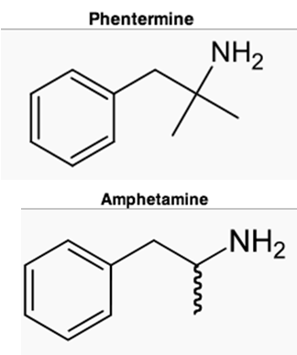
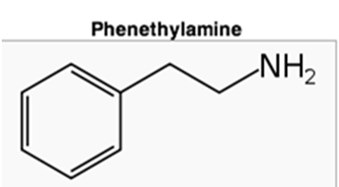
Adipex
• β‐phenylethylamine is a norepinephrine releaser
• Acts centrally on hypothalamus and limbic system
• Produces decreased appetite/eating restraint
Obesity:Evaluation and Treatment Essentials;2010:81‐99

Slide 52
Adipex
The longest published placebo-controlled trial of phentermine lasted 36 weeks in 108 obese women treated with phentermine 30 mg per day either continuously or intermittently (alternating months) and found similar weight loss in the continuous (12.2 kg) and intermittent (13.0 kg) groups vs 4.8 kg with placebo
Br Med J. 1968;1(5588):352-354.

Slide 53
Adipex
Several short-term placebo-controlled studies of phentermine have shown elevations in pulse or smaller decreases in pulse, blood pressure, or both, than would be expected given the degree of weight loss.
Blood pressure improvement weight loss and maintenance during long-term phentermine pharmacotherapy for obesity.
Hendricks EJ, et al. Obesity 2011;19(12):2351-2360.

Slide 54
Adipex
The dose?
“the more the better” for appetite effect…vs. “less is more”…
The Verdict: FDA Qsymia: “least plus combination”

Slide 55
Adipex
Most common Side Effects:
insomnia
headache
dry mouth
constipation

Slide 56
Adipex (safety)
Phentermine is a Schedule IV
• No amphetamine‐like withdrawal symptoms
• No binge use of phentermine
• No phentermine cravings
Hendricks EJ et al. Am J of Therapeutics 2011;18:292‐99

Slide 57
Other Sympathomemtics
Diethylpropion (Tenuate)has a similar adverse effect and weight loss profile to phentermine, but is much less frequently prescribed,
Phendimetrazine (Adipost, Bontril…) despite the paucity of randomized controlled trials, is prescribed 3 times more frequently than diethylpropion for obesity treatment,
Benzphetamine (Didrex) is less commonly prescribed for obesity treatment than the other noradrenergic drugs

Slide 58
Part III
Weight “Promoting” Meds

Slide 59
Weight Promoting Meds
When considering the initiation of pharmacotherapy for weight loss, it is also a good time to review the other medications that the patient is taking and discontinue those associated with weight gain or substitute with a weight neutral medication, if possible.

Slide 60
Weight Promoting Meds
Insulin
Sulphonylureas (SU)
Beta-blockers (carvedilol least likely to do so)
Antipsychotics (very weight positive plus metabolic risk)
TCA (except Portiptyline-Vivactil)
Other (Prednisone…)

Slide 61
Part IV
Other Medications
for Obesity Prevention or Treatment

Slide 62
Metformin
Metformin, increasingly used off label in patients with prediabetes and other insulin-resistant states, produces small sustained weight losses of about 2% relative to placebo.
Metformin improves insulin sensitivity, has a good safety profile, and long-term clinical experience.
Metformin has also been used to prevent or ameliorate weight gain with atypical antipsychotic agents and mood stabilizers.

Slide 63
Symlin
Pramlintide (Symlin) is a synthetic analogue of human amylin, which is administered subcutaneously at meal times as an adjunct to insulin for patients with type 1 and type 2 diabetes.
A meta-analysis of 8 studies in patients with type 2 diabetes and obese nondiabetic populations found additional weight loss relative to placebo.

Slide 64
Topamax
Topiramate, strongly weight negative.
classically an anti-seizure medication, migraine prophylaxis. Also used (off label) bipolar d/o, diabetic neuropathy…
Modulates GABA centrally (??appetite effect) and Na/Ca ion channels peripherally (i.e carbonic anhydrase and mild diuretic)

Slide 65
Topamax
Side effects:
- paraesthesias
- dyslaxia
- “brain fog” with short term memory loss.
- kidney stones (higher doses)
pregnancy risk D (cleft lip)
Note: also decrease OCP effectiveness

Slide 66
Zonisamide
Zonisamide, an antiepileptic medication, also induces weight loss.
At the daily dose of 400 mg moderately enhanced weight loss achieved with diet and lifestyle counseling but had a high incidence of adverse events.
JAMA. 2013;310(6):637-638.

Slide 67
Emaptic
Coming soon…
Combination: Bupropion 360mg and Zonisamide 360mg

Slide 68
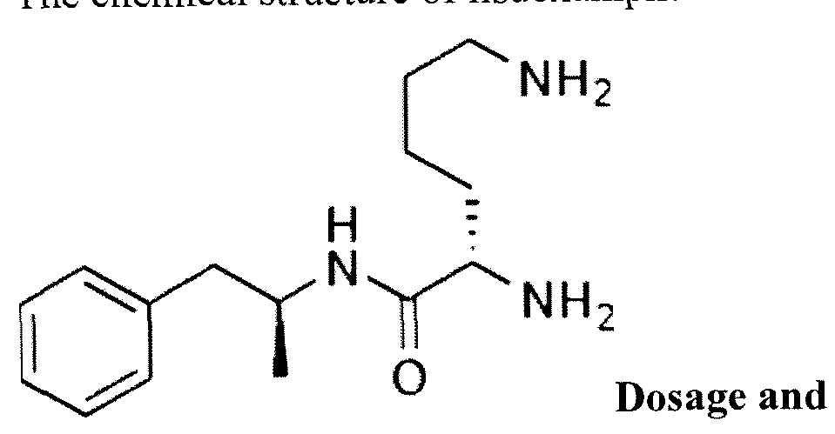

Vyvanse
Binge Eating Disorder???

Slide 69
Antidepressants
Wellbutrin (Bupropion)
A good choice when considering obesity (or overweight) and depressive conditions. note: contraindication is seizure d/o.
Prozac and Zoloft, ? weight neutral
(Note: SSRIs not likely to cause wt gain if used less than 6 mo)

Slide 70
Testosterone
• 261 men with low testosterone (<12nmol/L) treated with 1g testosterone undecanoate at 0, 6 wks & every 12 wks for 5 years (no diet) weight loss at 5 years 10.5%
• Note: 29% to 53% of obese men have low testosterone (using normal range 12.1‐40nmol/L)
Yassin AA & Doros G. Clin Obes. 2013;3:73‐83

Slide 71
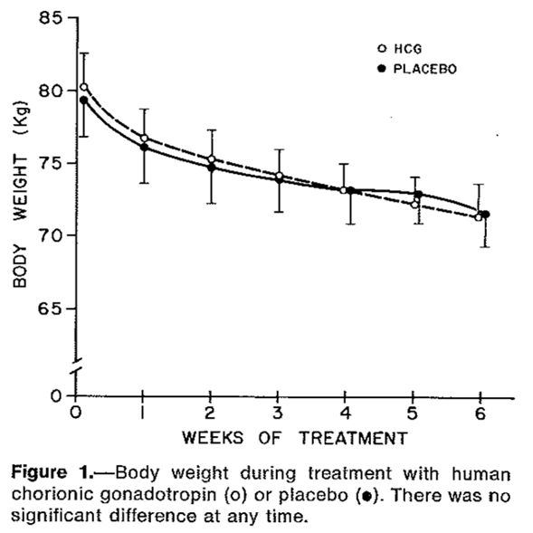
HCG Using Simeon’s Program … I say No!
Greenway FL & Bray GA. West J Med. 1977;127(6):769‐72.

Slide 72
other
Thyroid (T3/T4)
Vit-D
Vit-B12 (“lipotropic injections”)
Fiber
Probiotics

Slide 73
“substances” currently used or under investigation for weight
• Alpha Lipoic Acid
• Maitake mushrooms
• Glucomannan
• Sage tea
• Chromium
• Cinnamon
• Curcumin
• Vanadium
• Berberine
• Green tea extract
• Rasberry ketones
• Garcinia cambogia
• Hydroxycitrate
• Zinc
• Chitosan
• Green coffee beans
• Fucoxanthin
• Probiotics
• Conjugated Linoleic Acid

Slide 74
Thank You
Note for appointments and coverage: Dr.Tarrabain is first and foremost a primary care physician, yet more than two thirds of his daily schedule is dedicated for obesity. Most of his patients learn about him from existing patients, from primary care colleagues, and referrals from other specialty providers within network.
For appointments we suggest checking with our office referral coordinator Lucy Martinez (317) 5829256.
Patients may call office (317) 5829200 to get the Obesity Patient History form sent out and prepare for visit.

Slide 75
additional slides

Slide 76
Guidelines for drug treatment of obesity
Tips on how to select specific medications lacking
Unfortunately, the guidelines do not provide a pathway for how to choose among the various obesity medications.
This would have been helpful for clinicians.

Slide 77
When to stop med
If the patient does not respond with a reasonable weight loss within a few weeks, adherence to the medication, lifestyle intervention, and behavior therapy should be evaluated.
If adherence is verified and the patient remains unresponsive to the medication, or serious adverse effects occur, the medication should be discontinued.

Slide 78
Success
Institute of Medicine’s definition of success: >5% reduction in baseline weight at > 1 year follow-up of initial treatment
Its clinical significance is ultimately determined by long-term rather than short-term outcomes

Slide 79
Calories??
Bottom Line
• It’s the calories and all calories count
Eat less!
• Goal is a 500 -750 k/cal/day energy deficit
Prescribe 1200-1500 k/cal/day range (low calorie diet)

Slide 80
Exercise
“Exercise and diet go together. Weight management is most successful when careful attention is given to both physical activity and proper nutrition.”
American College of Sports Medicine, 2013
• Physical Activity: The Look AHEAD Study
– unsupervised
– 175 minutes moderate intensity/week
– 5 days/week
– walking!!!

